Slide 1
Polynomial Regression
Notes:
Instructional Note:

Slide 2

Objectives
Intro to Polynomials
Non-Linear Regression
Degrees/Orders of Polynomials
Bayesian information Criterion
Notes:
**All images cited in narration notes**
Image source: https://www.aceinfoway.com/blog/top-most-popular-databases

Slide 3
Intro to Polynomials
Polynomial Regression
… and why that matters!

Slide 4
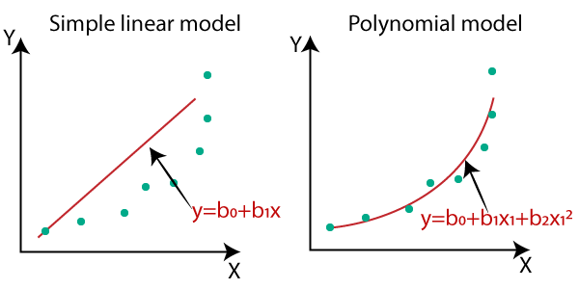
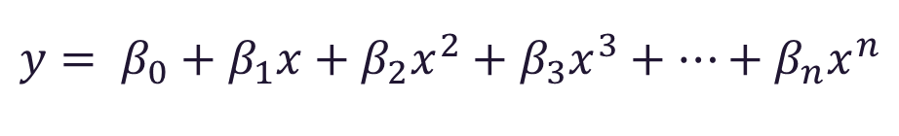
Intro to Polynomials
$$y= β_{0}+β_{1}x+β_{2}x^{2}+β_{3}x^{3}+…+β_{n}x^{n}$$
Polynomial Regression is a special case of Multiple Linear Regression that estimates the correlation using an nth degree polynomial in the equation.
Notes:
Citation of image shared
https://medium.datadriveninvestor.com/complete-guide-on-linear-regression-vs-polynomial-regression-with-implementation-in-python-964c64c28aa8
A form of Linear Regression. That due to nonlinear relationships between dependent and independent variables we add polynomial terms to either SLR or MLR to map their relationship.

Slide 5
Intro to Polynomials
Pro’s
Con’s
Polynomial provides the best approximation of the relationship between the dependent and independent variable.
A broad array of function can be fit under it.
Polynomial basically fits a wide range of curvature.
The presence of one or two outliers in the data can seriously affect the results of the nonlinear analysis.
There are fewer model validation tools for the detection of outliers in nonlinear regression than there are for linear regression.
Notes:
https://towardsdatascience.com/introduction-to-linear-regression-and-polynomial-regression-f8adc96f31cb

Slide 6

Intro to Polynomials
Polynomial Examples
$$y= β_{0}+β_{1}x+β_{2}x^{2}+β_{3}x^{3}+…+β_{n}x^{n}$$
$$y= β_{0}+β_{1}x+ \frac{5}{6}x^{2}+β_{3}x^{3}$$
$$y= β_{0}+β_{1}x+β_{3}x^{3}$$
Notes:
Polynomials do not have to have all terms in them to be valid
Degrees that are omitted are to be though about as x = 0
i.e. 0^2
To be noted
The order or degree that a polynomial is taken to is represented by the exponent of the final x
Example 1 is an nth order polynomial
Example 2 is a 3rd order polynomial
Example 3 is also a 3rd order polynomial
Order == degree

Slide 7


Is this a polynomial? $y= β_{0}+β_{0}x+ε$
Intro to Polynomials
Notes:
Technically yes even though it is known as simple linear regression it is actually 1st order polynomial
The advantage of polynomials is that terms can be added on to the tail

Slide 8
Non-Linear Regression
Polynomial Regression

Slide 9
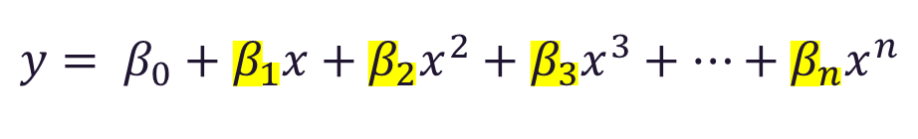
Non-Linear Regression
How is a non-linear line still considered in the category of linear regression?
$$y= β_{0}+β_{1}x+β_{2}x^{2}+β_{3}x^{3}+…+β_{n}x^{n}$$
The coefficients are all linear… Thus, this is a standard linear model.
Notes:
When we talk of linearity in linear regression, we mean linearity in parameters. So even if the relationship between response variable & independent variable is not a straight line but a curve, we can still fit the relationship through linear regression using higher order variables.
So linearity has basically two explanations.one is linear in variable & the other is linear in parameters.The linearity assumption in linear regression means the model is linear in parameters (i.e coefficients of variables) & may or may not be linear in variables.Confused ??
Look at the below equations :
Y =a + bx — — -(1)
Is linear in both variable & parameter as both coefficient “b” & variable “X" has highest power 1 in the equation.
Y= a+bx+cx^2 — — -(2)
https://medium.com/@biswajit3071976/what-does-the-term-linear-in-linear-regression-mean-97ef717bed7b

Slide 10
Degrees/Orders of Polynomials
Polynomial Regression

Slide 11
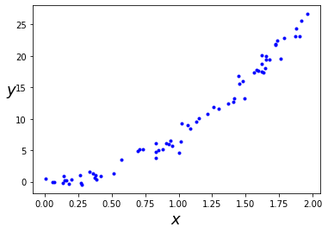
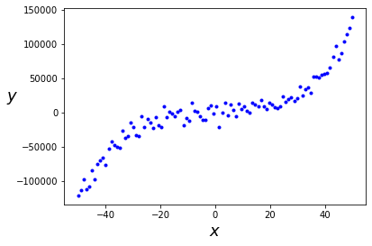
Degrees/Orders of Polynomials
When to use which order/degree
Second Order
Third Order
Notes:
There is not really a limit to the ORDER/DEGREE that a polynomial can go to.
The general soft limit is that it should not exceed the number of data points that are available.

Slide 12
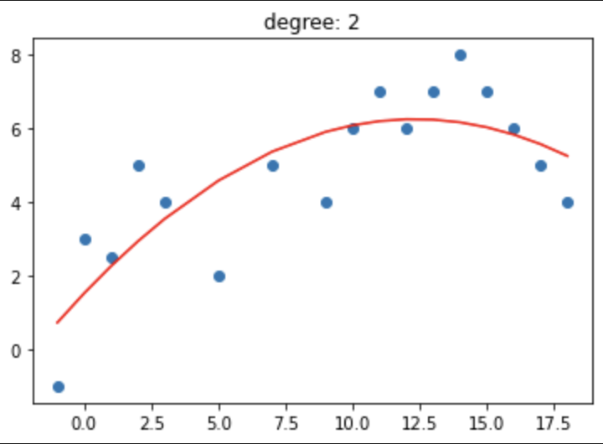
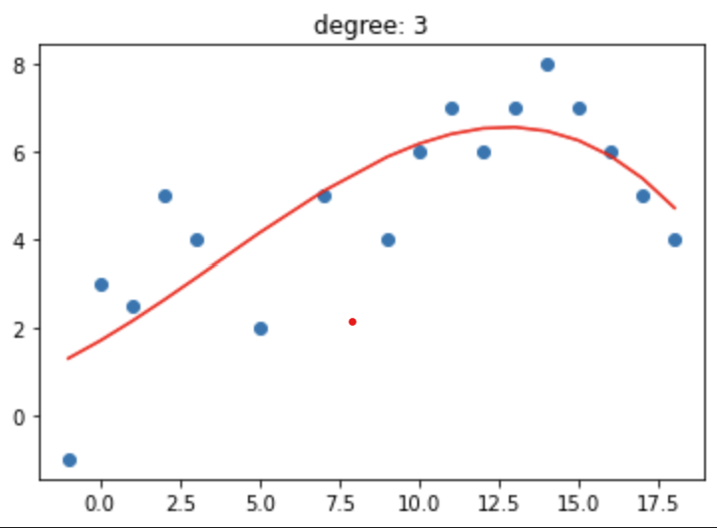
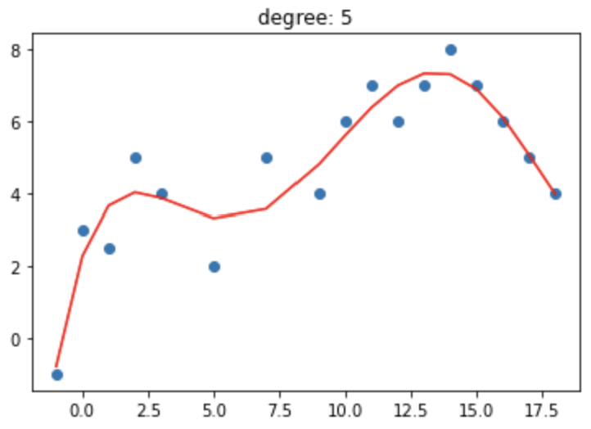
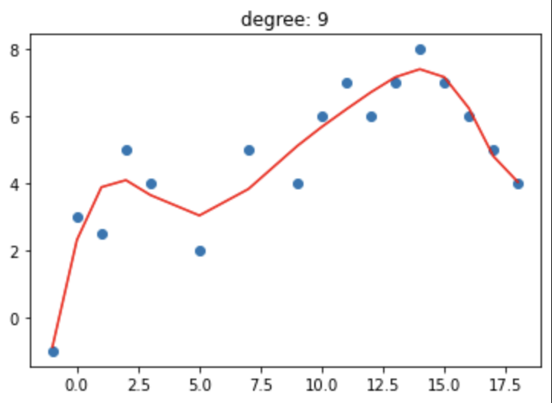
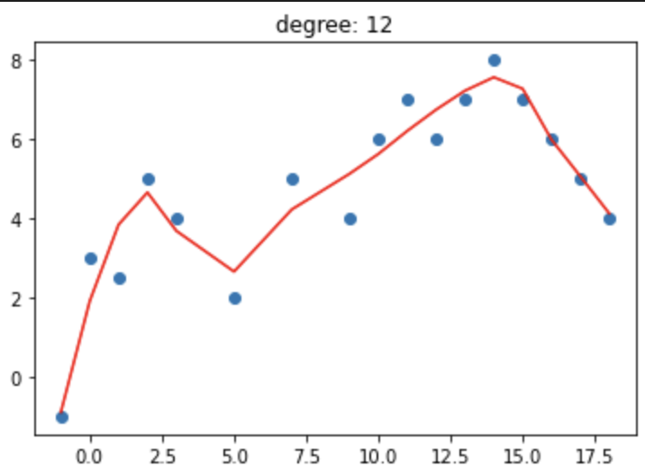
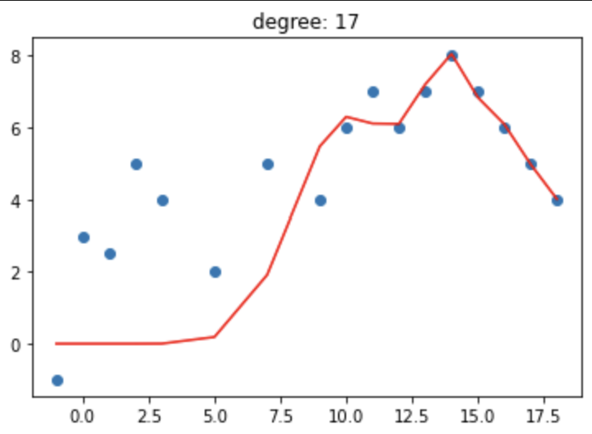
Degrees/Orders of Polynomials
Which Degree Fits Best?
Notes:
Ask the class which degree would be best to use.
Introduce the idea of underfitting and over fitting
We will use this slide as reference for the next Objective (BIC)

Slide 13
Bayesian Information Criterion
Polynomial Regression

Slide 14

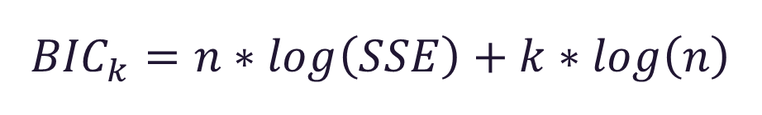
Bayesian Information Criterion
BIC:
Method for scoring and selecting a Model.
Can be repetitively calculated in order to justify the degree or order that a polynomial is taken to.
Can tie break a close $R^{2}$
$${BIC}_{k}=n∗log\left(SSE\right)+k∗log\left(n\right)$$
As complexity of the model increases, bic value increases and as likelihood increases, bic decreases. So, lower is better.
Notes:
n = the number of data points in x, the number of observations, or equivalently, the sample size;
k is the number of regressors, including the intercept;

Slide 15
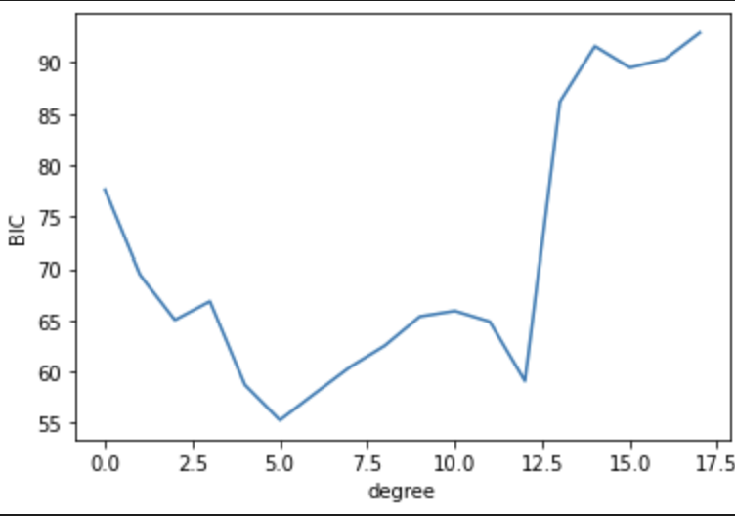
Bayesian Information Criterion
5th degree would be closest
BIC Scores
Notes:
Using the options from slide 12, find the most appropriate model
The objective of a calculating the BIC score is to find the lowest possible value. This will ensure that the model is not overfitted.

Slide 16

What’s Next for us? Practice Lab Homework/Review
Polynomial Regression

Slide 17
In this lesson, we discussed and explored: Intro to Polynomials Non-Linear Regression Degrees/Orders of Polynomials Bayesian information Criterion
Polynomial Regression
Notes:
Instructional Note:

Slide 18
Digging Deeper?
https://medium.datadriveninvestor.com/complete-guide-on-linear-regression-vs-polynomial-regression-with-implementation-in-python-964c64c28aa8
(Polynomials vs Simple Linear Regression)
https://www.youtube.com/watch?v=DmYV5cma7cQ (Polynomial Regression in R)
https://statisticsbyjim.com/regression/interpret-coefficients-p-values-regression/ (Interpreting P-value and Coefficients)

Slide 19
Questions?
admin@rockborne.com

